Slide 1
7. Hypothesis Testing

Slide 2
The study showed a 95% reduction in symptomatic COVID-19 cases in the people who received the vaccine compared with people who received a dummy drug.
The efficacy of preventing hospitalization, severe illness and death is 100.00%, the efficacy of preventing obvious symptoms and requiring medical treatment is 83.70%, and the efficacy rate of preventing mild symptoms without medical treatment is 50.65%.
https://www.covidvaccine.gov.hk/en/faq

Slide 3
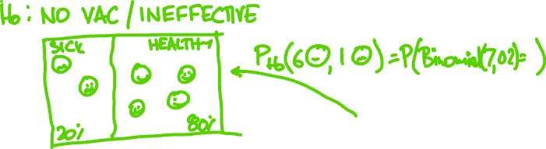

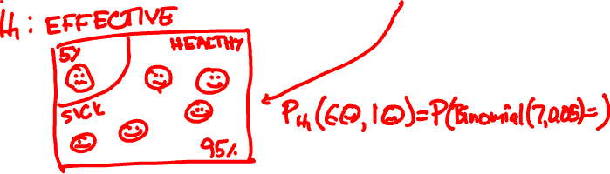
How to test if a vaccine is effective?

Slide 4
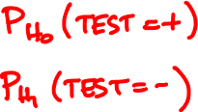
Hypothesis testing terminology
Hypothesis: PDF/PMF of a random variable
Null H₀: Default PMF/PDF
Alternative H₁: Conjectured PMF/PDF
Test: outcome → {+, –}
False positive (type I error):
False negative (type II error):

Slide 5
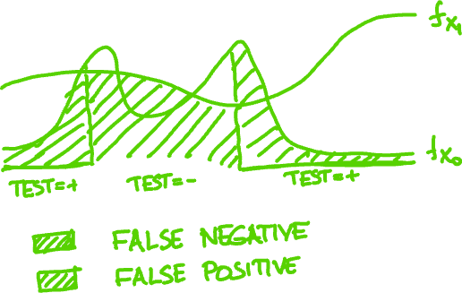
Hypothesis testing

Slide 6
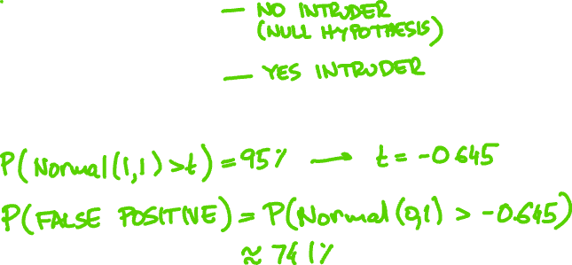
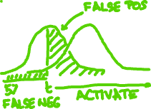
A car-jack detector outputs Normal(0, 1) if there is no intruder and Normal(1, 1) if there is.
You want to catch 95% of intrusions. What is the probability of a false positive?

Slide 7


Neyman-Pearson Lemma
Among all tests with given false negative probability, the false positive is minimized by the one that picks samples with largest likelihood ratio
f_{X} (x)
₁
f_{X} (x)
₀

Slide 8


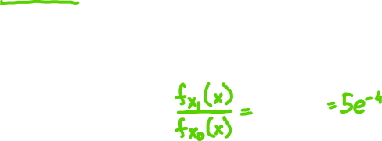
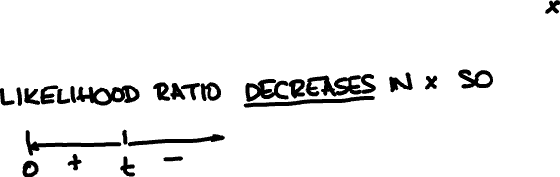
Rain usually falls at 1 drop/sec. You want to test today’s rate is 5/sec based on first drop. How to set up test with 5% false negative?

Slide 9
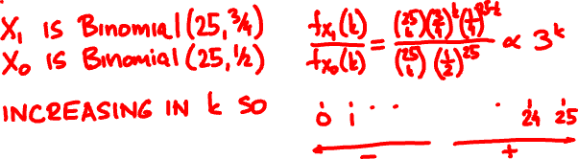

A drug is claimed effective on ¾ of patients. The null hypothesis is ½. How to set up a trial for 25 subjects with 10% false positive?

Slide 10
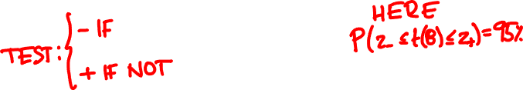

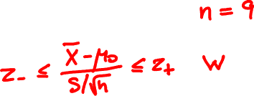

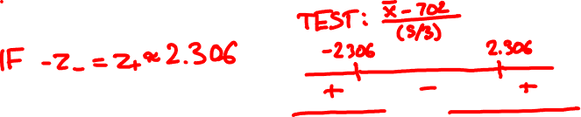
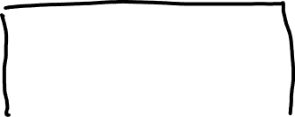
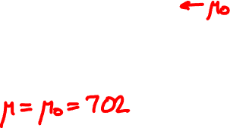
The official height of Ma On Shan is 702m. Design a test with 5% false positive from 9 measurements.

Slide 11


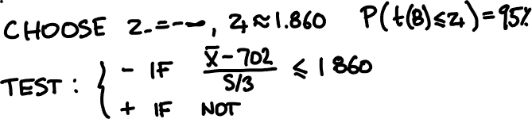
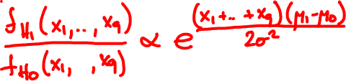

Your alternative hypothesis is that it is at least 720m tall. Does this change the test?

Slide 12
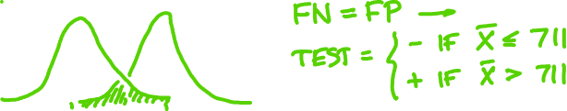

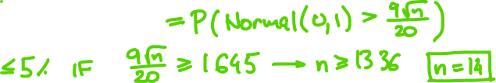

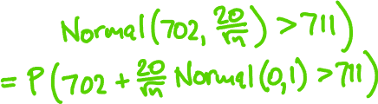
Assume σ = 20m. How many samples do you need for 5% false positive and false negative?

Slide 13
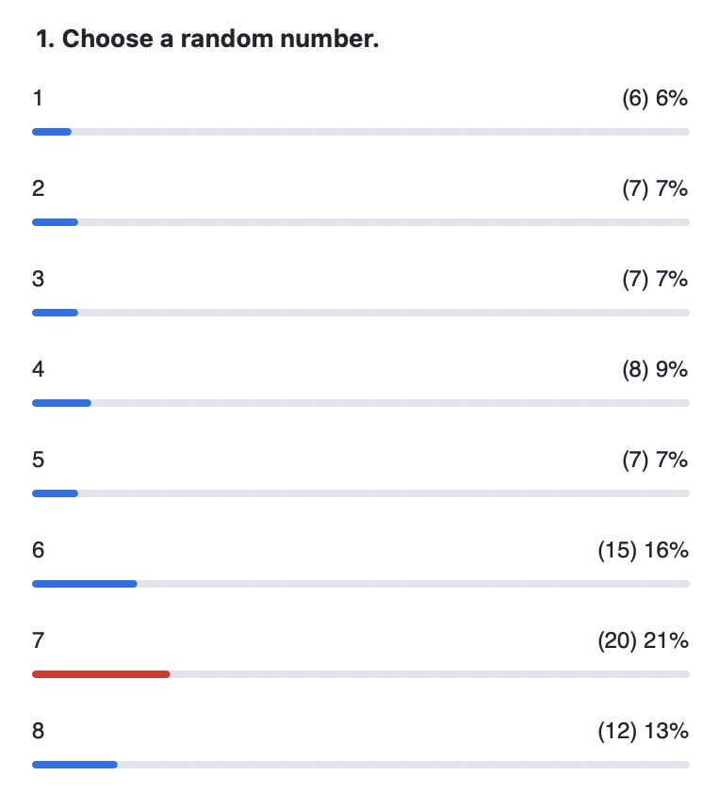

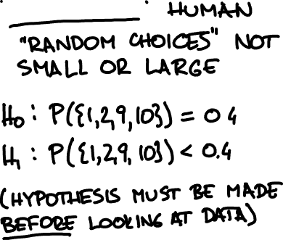


Slide 14



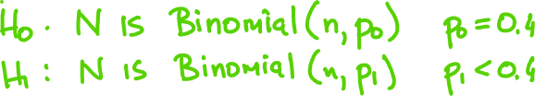
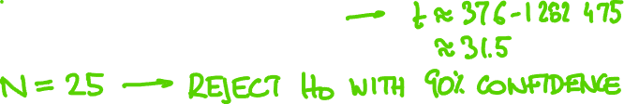
How random is your random choice?

Slide 15
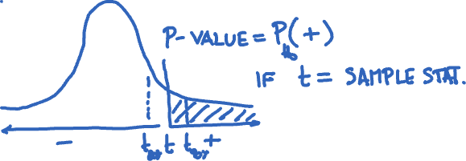
p-value
The p-value is the smallest value of the type I
error that would have caused the test to
reject the null hypothesis for a given outcome

Slide 16




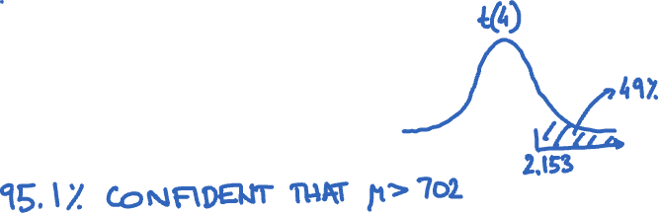
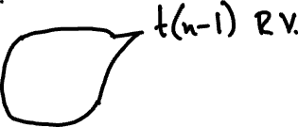
Measurements of Ma On Shan yield 707, 720, 715, 727, 697 metres. What is the p-value?

